Slide 1
AMPLITUDE MODULATION
SUPRIYA GHOSH
ROLL NO:16800117010
DEPT:CSE
YEAR:3rd
sub-computer networking

Slide 2
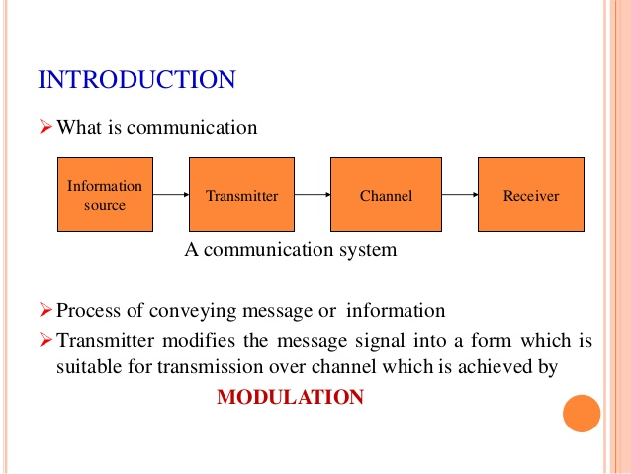

Slide 3
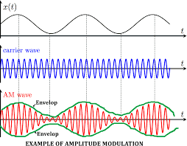
Amplitude modulation
Amplitude modulation (AM) is a modulation technique used in electronic communication, most commonly for transmitting information via a radio carrier wave. In amplitude modulation, the amplitude (signal strength) of the carrier wave is varied in proportion to that of the message signal being transmitted.

Slide 4
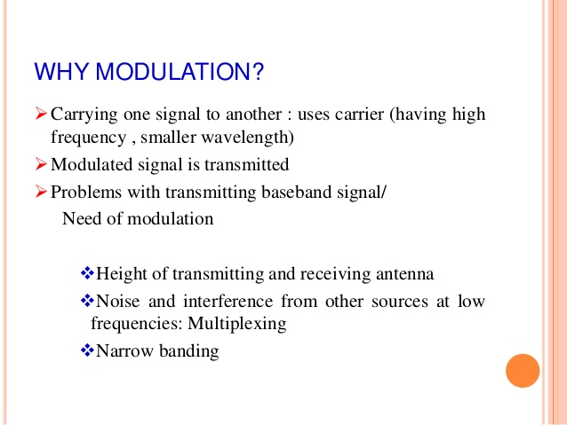

Slide 5
Types of Amplitude Modulation
There are three main types of amplitude modulation. They are;
Double sideband-suppressed carrier modulation (DSB-SC).
Single Sideband Modulation (SSB).
Vestigial Sideband Modulation (VSB).
Why Do We Need Modulation?
Practically speaking, modulation is required for;
High range transmission
Quality of transmission
To avoid the overlapping of signals.

Slide 6
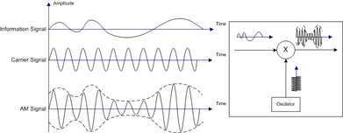
Simplified analysis of standard AM
Illustration of amplitude modulation
Consider a carrier wave (sine wave) of frequency f_{c} and amplitude A given by:
.
Let m(t) represent the modulation waveform. For this example we shall take the modulation to be simply a sine wave of a frequency f_{m}, a much lower frequency (such as an audio frequency) than f_{c}:
,
where m is the amplitude sensitivity, M is the amplitude of modulation. If m < 1, (1 + m(t)/A) is always positive for undermodulation. If m > 1 then overmodulation occurs and reconstruction of message signal from the transmitted signal would lead in loss of original signal. Amplitude modulation results when the carrier c(t) is multiplied by the positive quantity (1 + m(t)/A)

Slide 7
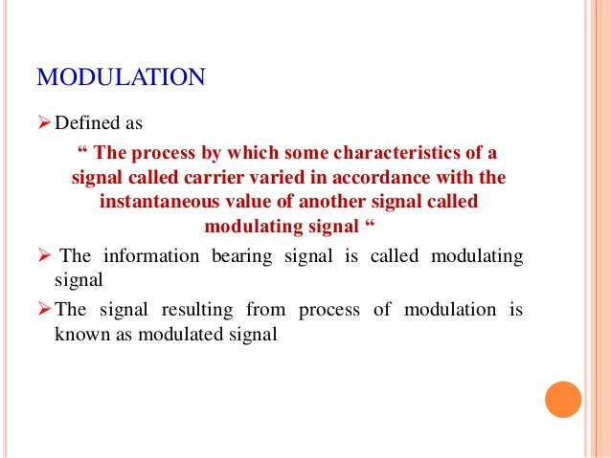

Slide 8
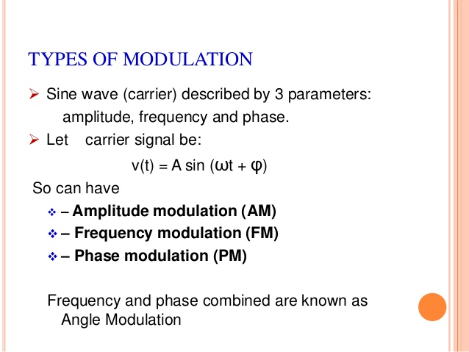

Slide 9
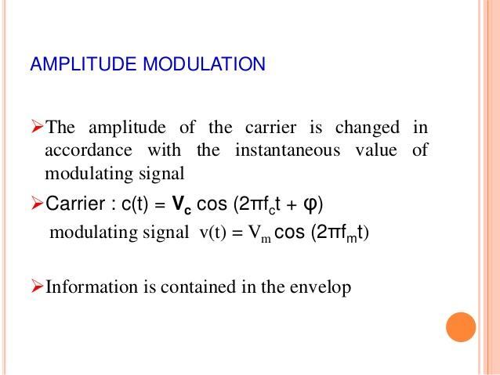

Slide 10
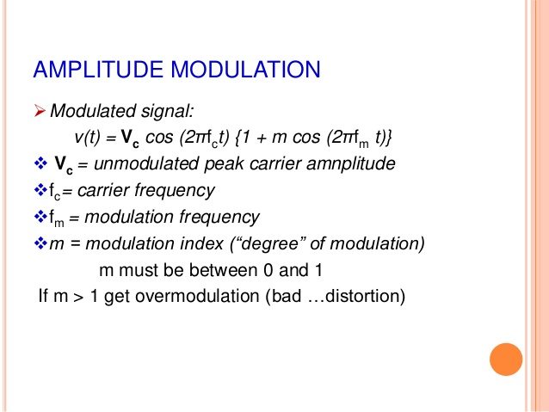

Slide 11
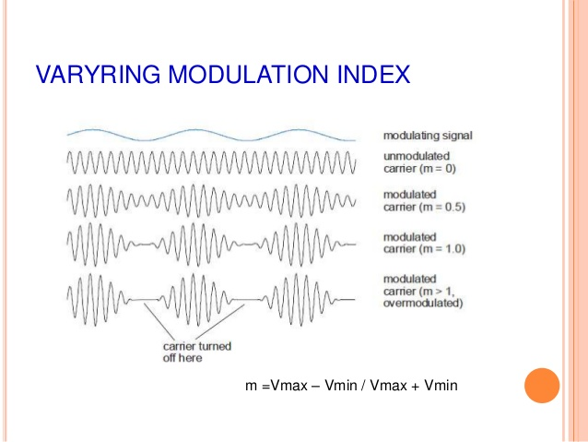

Slide 12
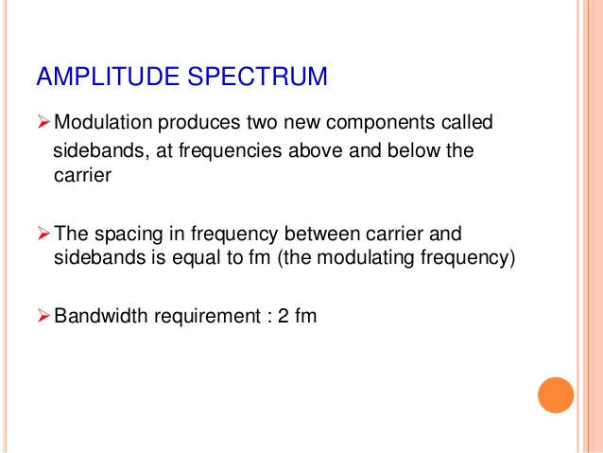

Slide 13
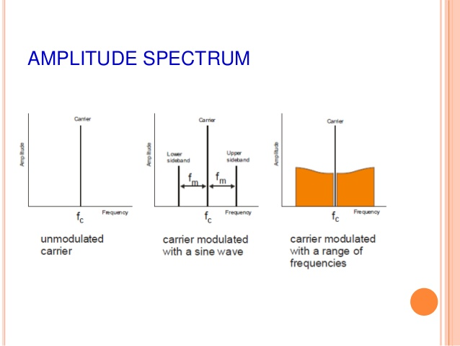

Slide 14
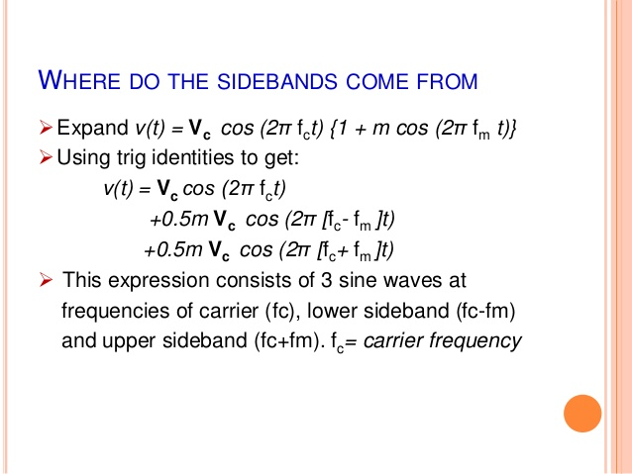

Slide 15
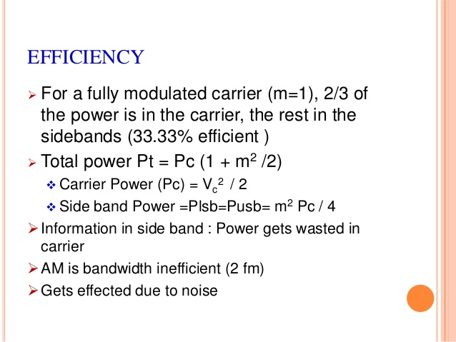

Slide 16
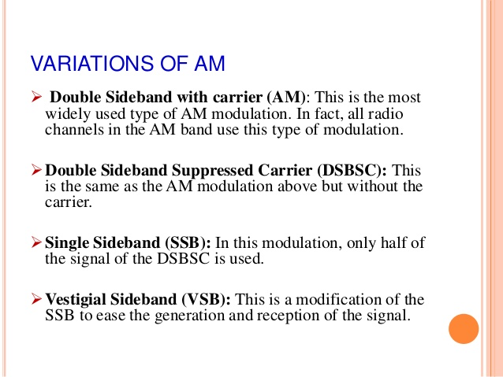

Slide 17
ADVANTAGES AND DISADVANTAGES
Advantages of Amplitude Modulation,AM
There are several advantages of amplitude modulation,and some of this reasons have meant that it is still in widespread use today:
It is simple to implement
It can be demodulated using a circuit consisting of very few components
Disadvantages of Amplitude Modulation
In is not efficient in terms of it power usage
It is not efficient in terms of its bandwidth
It is prone to high levels of noise

